Slide 1


Slide 2

TEAM ID: 12
ARDUINO
OBSTACLE AVOIDING
LINE FOLLOWER
ROBOT​

Slide 3





TEAM MEMBERS:
ANKIT KUMAR PATEL
DIDWM MOCHAHARY
22ME10008
22ME10027
Team leader and procurement of components, Making electrical connections, coding, debugging the code.
Designing circuit in TinkerCAD, testing the working of components. coding, debugging the code.
SAMPRIT SAHA
SUBHANSHU KUMAR
22CE10066
22MA10060
Assembling the components, testing the working of components and preparing the presentation.
Designing circuit in TinkerCAD, coding, debugging the code.

Slide 4
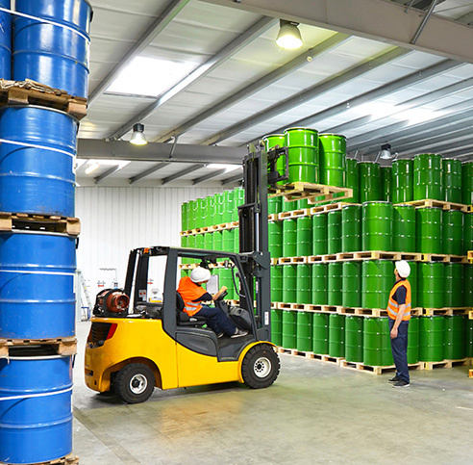
BACKGROUND AND MOTIVATION​:
Employee safety is a prime concern in various industries, including logistics and warehousing, manufacturing, metals & heavy machinery, and automotive, as workers are required to accomplish potentially dangerous activities and work in environments that pose a threat to personal safety. In most of these industries, tasks such as loading, unloading, storage, and movement of goods are carried out manually, putting human workers at risk
AGVS ensure reduced instances of accidents and greater safety of workers.
Industries are focusing on improving workplace safety to eliminate accidents, reduce downtime, and increase productivity. There is growing awareness about AGVS, and an increasingly large number of companies are implementing AGVS in their warehouses. These vehicles are capable of lifting heavier weights and can transport materials without delay. Intelligent unmanned vehicles are less prone to errors and help companies reduce accidents and ensure safety at the workplace.

Slide 5

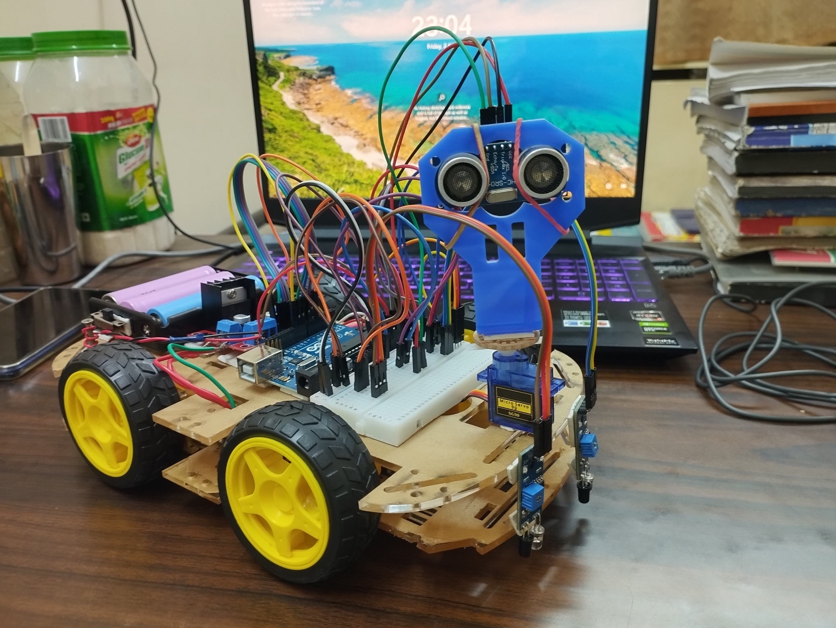

OBJECTIVE:​
TO DESIGN A LINE FOLLOWER ROBOT THAT CAN AUTONOMOUSLY FOLLOW A SPECIFIC PATH MARKED BY A LINE, ALONG WITH THE FUNCTIONALITY OF AVOIDING OBSTACLES.

Slide 6




METHODOLOGY: ​
THE IR SENSORS TRACK THE PATH AND ULTRASONIC SENSOR SENSE THE OBSTACLE ON THE LINE PATH. IF THERE IS ANY OBSTACLE, THE CAR AUTOMATICALLY DIVERTS ITS POSITION TO LEFT OR RIGHT, AVOIDES THE OBSTACLE AND AGAIN RETURNS BACK TO IT'S ORIGINAL PATH.

Slide 7
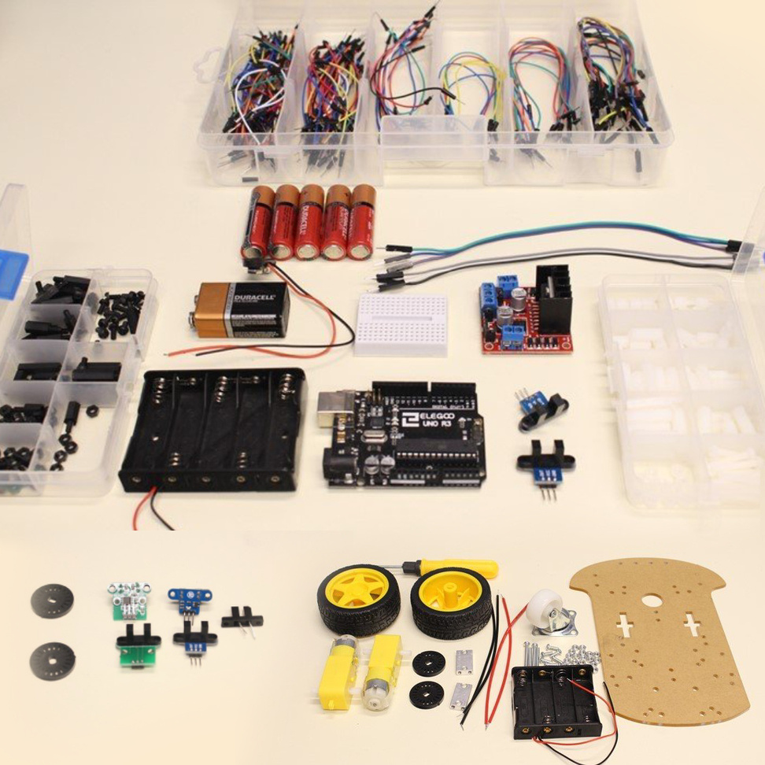
Items used :
1
Arduino Uno R3 Development Board with ATMEGA328​
2
L298N Motor Driver/Servo Shield for Arduino​
3
Digital IR Sensors Obstacle Avoidance Module(x2)
4
HC-SR04 Ultrasonic Sensor​
5
Mini Servo Motor SG - 90 180° Rotation
6
100 RPM BO Motor Double Shaft I ​Shape connected with wheels.​ (x4)
7
20cm Female-Female, Male-Female,​Male-Male
8
Ultrasonic Sensor Holder​
9
Acrylic Chassis​
10
12V HW Battery​

Slide 8
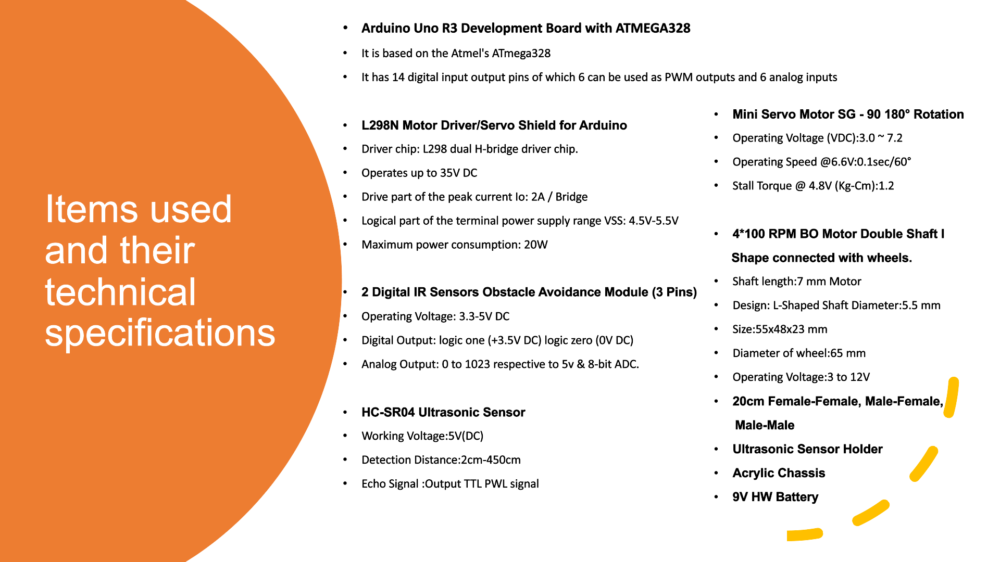

Slide 9







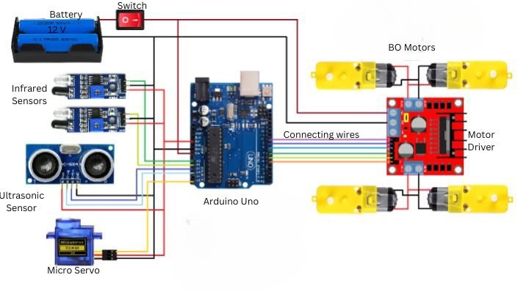

Circuit diagram of the Project

Slide 10
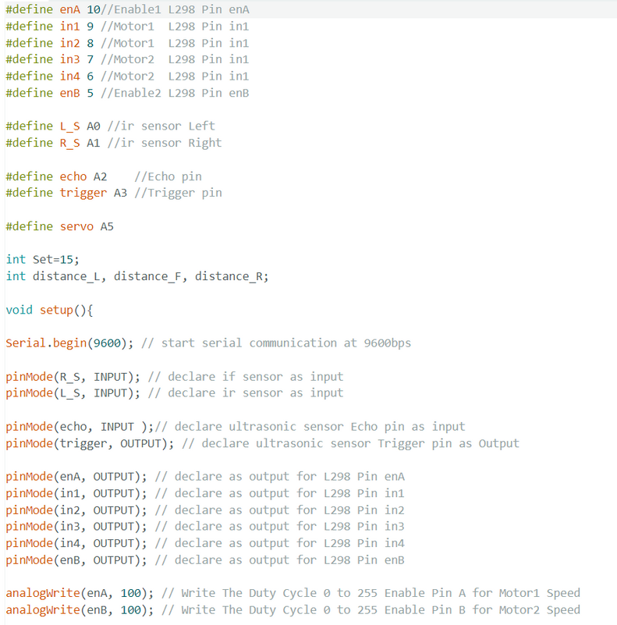
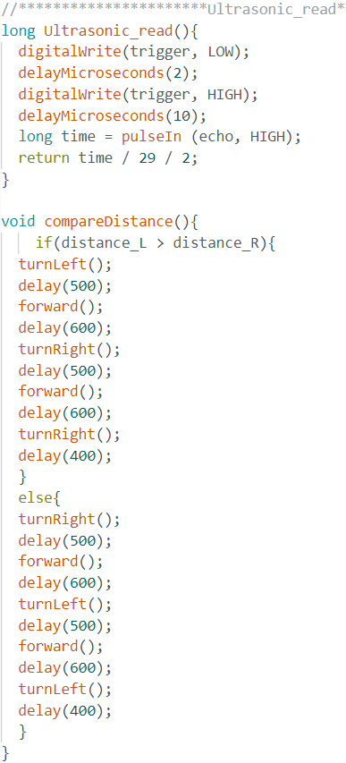
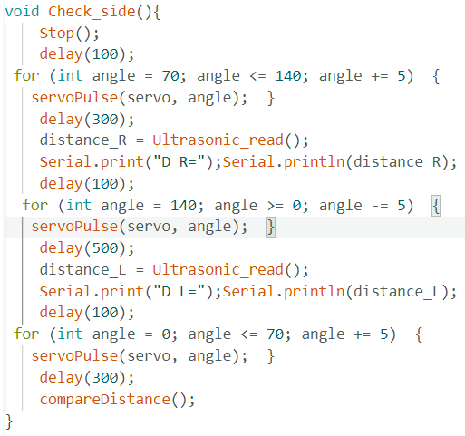
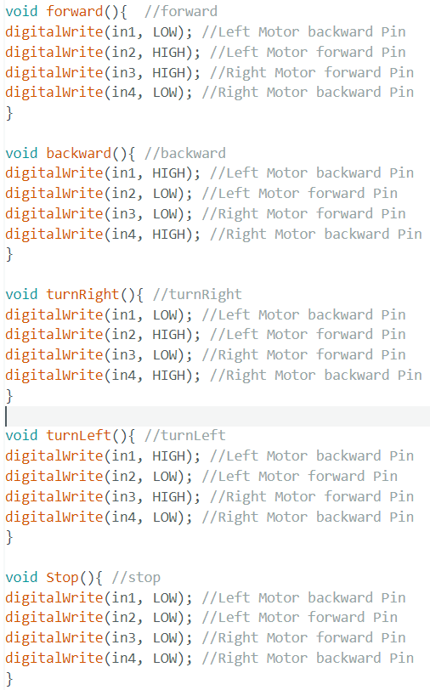
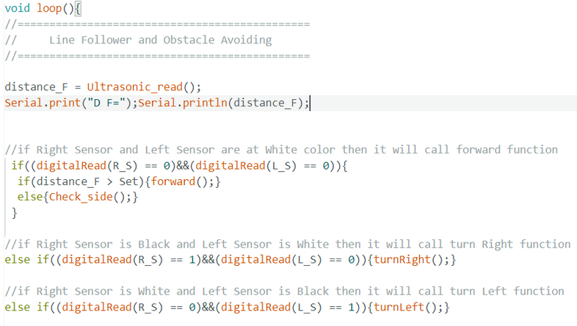
CODE

Slide 11



CHALLENGES FACED AND SOLUTIONS FOUND​​
DURING THE DIY PROJECT OF THE ARDUINO OBSTACLE AVOIDANCE LINE FOLLOWER ROBOT, WE FACED CHALLENGES IN SENSOR INTEGRATION AND MOTOR CONTROL. THROUGH METICULOUS TESTING AND CALIBRATION, WE ACHIEVED ACCURATE SENSOR READINGS. ITERATIVE ADJUSTMENTS AND RE-TESTING THE CODE WITH DIFFERENT VALUES ENABLED US TO OPTIMIZE MOTOR CONTROL FOR SMOOTHER NAVIGATION. WE FACED THE PROBLEM OF POWERSUPPLY FROM 9V BATTERY WHICH WAS SOLVED BY USING 12V BATTERY.

Slide 12


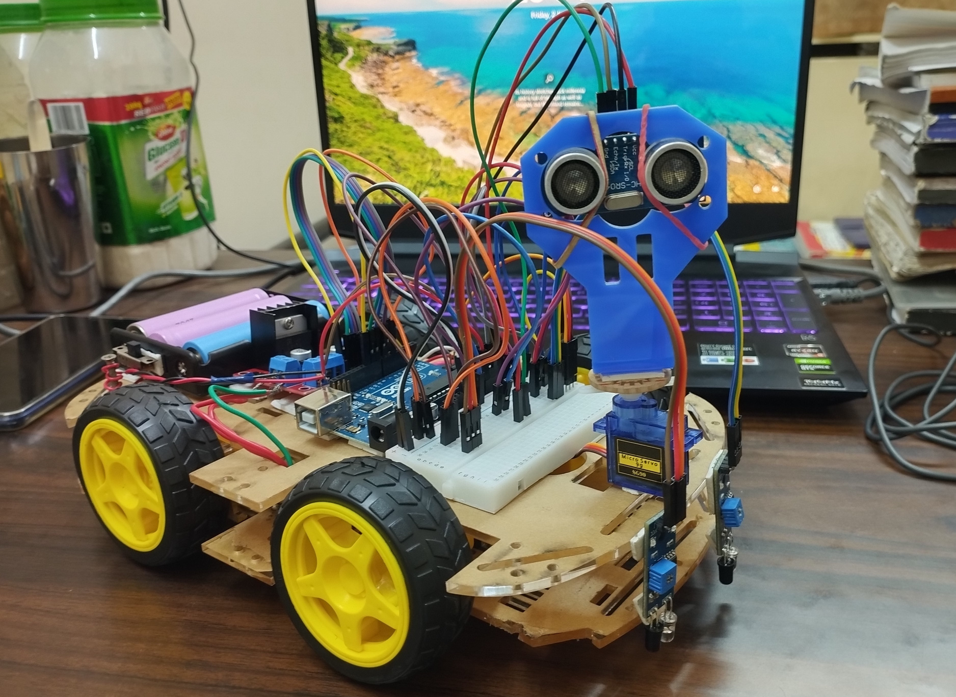

TEAM:
12
PHOTO OF FINAL SYSTEM​

Slide 13
LEARNING’S FROM THE PROJECT​
Throughout the process of creating the Arduino Obstacle Avoidance Line Follower Robot, our team learned invaluable lessons. We gained a deep understanding of coding, electronics, and robotics principles. We encountered and overcame numerous challenges, enhancing our problem-solving and troubleshooting abilities. Collaboration was key as we worked together, pooling our strengths and ideas to achieve success. Patience and persistence became virtues as we faced setbacks and setbacks, continually iterating and improving our design. Moreover, this project fostered a passion for innovation and sparked our curiosity for further exploration in the realm of robotics. Overall, the experience enriched our knowledge, skills, and passion for DIY projects and technology.
Throughout the process of creating the Arduino Obstacle Avoidance Line Follower Robot, our team learned invaluable lessons. We gained a deep understanding of coding, electronics, and robotics principles. We encountered and overcame numerous challenges, enhancing our problem-solving and troubleshooting abilities. Collaboration was key as we worked together, pooling our strengths and ideas to achieve success. Patience and persistence became virtues as we faced setbacks and setbacks, continually iterating and improving our design. Moreover, this project fostered a passion for innovation and sparked our curiosity for further exploration in the realm of robotics. Overall, the experience enriched our knowledge, skills, and passion for DIY projects and technology.

Slide 14







CONCLUSION
In conclusion, the journey of our team in creating the Arduino Obstacle Avoiding Line Follower Robot​has been both challenging and rewarding. Through countless hours of research, coding, and debugging, we have successfully built a functional and versatile robot that can navigate its surroundings and follow designated paths. This DIY project has not only honed our technical skills in robotics and programming but has also fostered teamwork, problem-solving, and innovation. As we reflect on this project, we are proud of the knowledge gained, the obstacles overcome, and the excitement of witnessing our creation in action. This experience has truly sparked our passion for robotics and opened doors to endless possibilities for future projects.

Slide 15


References:
Guide to Make Arduino
Obstacle Avoidance Line Follower Robot
Scratch Code

Slide 16


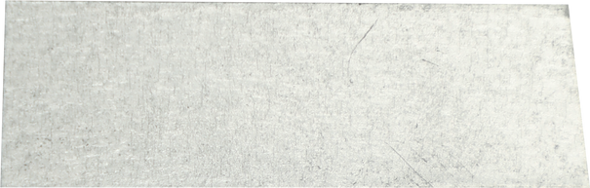



YouTube link for video demonstration of the project

Slide 17
THANK YOU
TEAM:12

Slide 18

Any questions?
Let's work together

